Slide 1
Internet & WWW
K.Vigneswara Reddy M.Tech.
Asst. Professor,
IT Dept,
SNIST HYD.

Slide 2
Computer Networks
A Computer Network is the interconnection of computers to perform sharing of resources and providing communication between two or more computers.
Types of Computer Networks:
There are 2 categories of networks…
1. Single Peer-to-Peer Network:
Connecting only two computers to provide sharing and communication between them.
2. Broadcast Network:
Connecting more than two computers to provide sharing and communication between them. In these type of
networks the communication message can be send to a group of computers separately

Slide 3
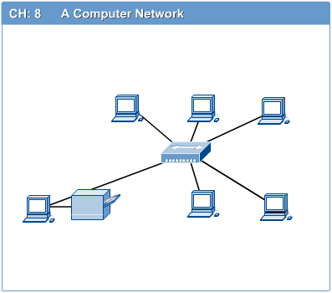

Slide 4
LAN, MAN & WAN
Network in small geographical Area (Room, Building or a Campus) is called LAN (Local Area Network)
Network in a City is call MAN (Metropolitan Area Network)
Network spread geographically (Country or across Globe) is called WAN (Wide Area Network)

Slide 5
Internet:
The Internet is a collection of networked computers all over the world.
(or)
A collection of networks interconnected by a set of routers, which allows them to function as a single, large virtual network.
(or)
A global network of networks connecting millions of computers.
(or)
The cast collection of interconnected networks, that all use the TCP/IP protocols and that evolved form the ARPANET of the late 60’s and early 70’s.
The Internet was originally developed in 1969 for the US military and gradually grew to include educational and research institutions. Today commercial industries, corporations and residential users all are using the Internet widely.

Slide 6

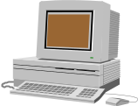
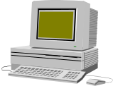
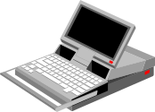

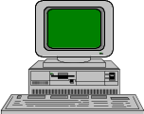
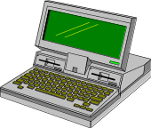
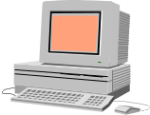
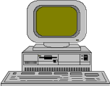
The Internet
Every machine transparently connected to other machines

Slide 7
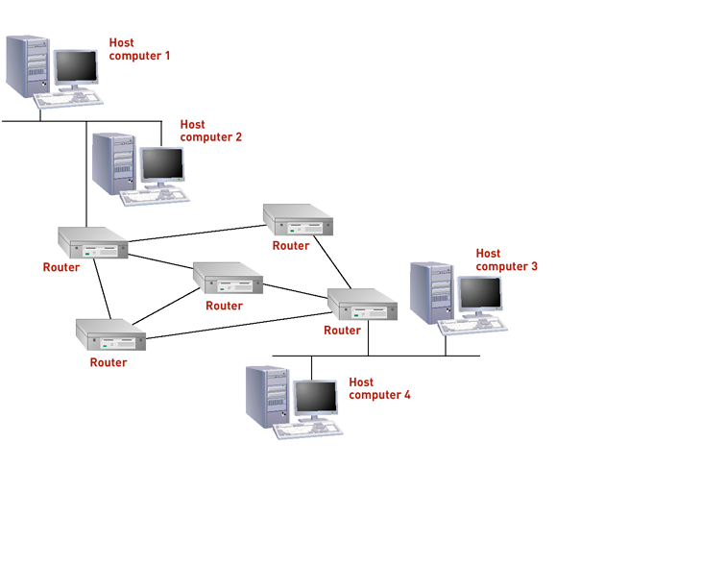

Slide 8
Computers on the Internet use Client/Server Architecture in which remote server provides file and services to the user’s local Client machine.
Services of the Internet:
E-Mail.
FTP (File Transfer Protocol).
Multimedia Streaming.
WWW (world Wide Web).
Rich site summary.
News groups.
List Servers
Video conferencing
Chat
Blogging
etc…..

Slide 9
Internet Concepts:
1. Packets:
Over the Internet, the information is broken down into smaller pieces called Packets.
Each packet travels in different path individually over the Internet to reach the destination.
2. Router:
It is a specified computer that regulates traffic on the Internet & picks most efficient route for each packet.
3. Gateway:
It is a H/W or S/W that links 2 networks that work differently, such as Novell and Windows NT.
4. Server:
It is a part of network that supplies files & services to client .
1. File server 2.Print server 3.Mail server
5. Webpage:
A resource of information on the web.
6. Website:
Collection of web pages related to a common domain name or sub-domain name on the web.

Slide 10
7. HTML:
The coding Language used to design and control documents on the web.
8. Hypertext:
The web page information.
9. Hyper Link:
Connection to other webpage.
10. WWW:
Interconnection of Internet Servers that supports HTML.
11. Downloading and Uploading:
Receiving and sending information from and to the Internet respectively

Slide 11
Components need in Internet Connection:
NIC (Network Interface Card).
Web Browser.
TCP/IP Protocol Suite.
ISP (Internet Service Provider) account.
Modes of Connection:
Telephone-Modem.
Ethernet.
ISDN (Integrated Services Digital Network).
Cable Modems.
DSL (Digital Subscriber Line).
SDSL (Synchronous DSL).
ADSL (Asynchronous DSL).
Satellite.

Slide 12
WWW (World Wide Web)
It is a interlinked hypertext system that allows documents to be shared over the Internet.
WEB was invented in 1989 by Tim Berners Lee at European organization for nuclear research (CERN) in Geneva, Switzerland.
Internet Protocols
DNS (Domain Name System)
POP3 (Post Office Protocol Version 3)
SMTP (simple Mail Transfer Protocol)
IMAP (Internet Message Access Protocol)
HTTP (Hyper Text Transfer Protocol)
FTP (File Transfer Protocol)

Slide 13
IP Address:
Unique Identification for the Resources over a Network.
IPV4 version uses 4 number separated by periods.
each number ranges from 0-255.
EX: 198.116.142.34
Locating Web Resources (URL & DNS):
The web site address is also called as a URL (Universal Resource Locator).
URL Format:
Protocol://Location/path/file name
EX: http://www.india.gov.in/citizen/education.php
Protocol Location Domain name organization Country code Directory file name
Domain Names:
com - commercial
edu - Education
gov - Government
int - international
mil - military
net - network
org - organization

Slide 14
Search Engine
A search engine can be defined as a web site with tools which help you to find information on the web.
search engine is a coordinated set of programs to look for web pages & record information contained
there. The contents of these web pages are stored in database which you can search.
Spider: A program that visits websites & reads their pages to create entries for a search engine index.
Spider is also known as crawler or a bot.
Indexing program identifies text, links and other content in the page & stores it in the search engine’s
database.
Popular search engines:
google
yahoo
msn

Slide 15
Anti-Virus
It is a program that either comes installed on your system or that you purchase, it helps to protect your
system against viruses, worms, Trojan horses.
Fire Wall:
It is a S/W or H/W designed to protect your computer network from unauthorized access.
Types of Fire walls:
Software Fire wall: for personal computer only.
Hardware Firewall: for Home Networks that wants to connect to the Internet.
Wireless Firewall: for Wireless Internet.

